Slide 1


RGB LED Circuit
LED
+
+
+

Slide 2
Positive + (anode)
Negative - (cathode)

Slide 3
Simple Two Battery Circuit
+
+
+
3 volts
LED
Noodle
GND
+
+

Slide 4
3 Battery Pack
3 AA or AAA battery pack
+
15 ohm
+
4.5 volts
LED
Noodle
GND
+

Slide 5
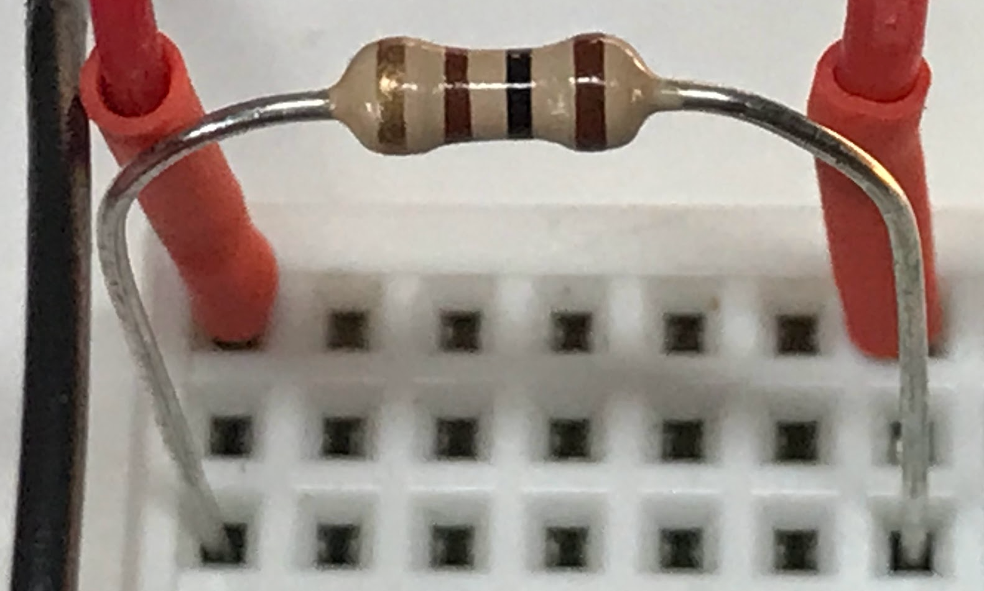
9-Volt Battery
100 ohm
LED
Noodle
9-Volt
Battery

Slide 6
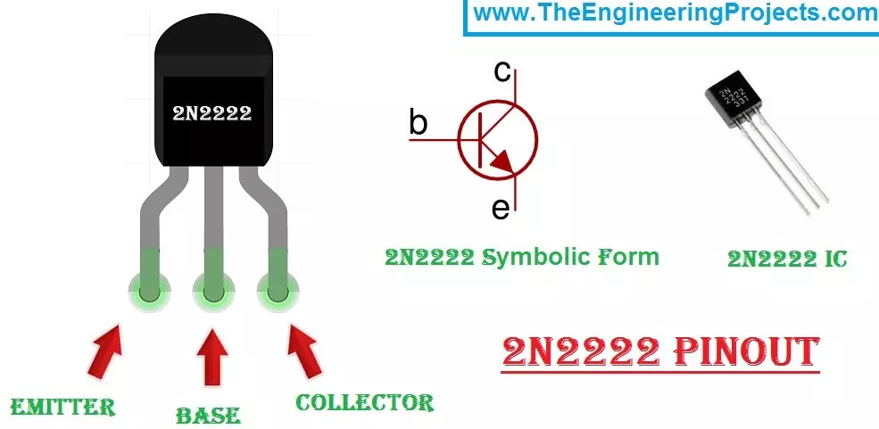
C
2N2222
B
E
C
E
B

Slide 7

Dimmer Circuit
5V
2N2222
LED Noodle
10K Pot
10K ohm
5 ma
100 milliamp limiting resistor
GND

Slide 8

5V
2N2222
LED Noodle
5 ma
10K ohm resistor
Pico
GPIO
15
15 ohm
100 milliamp limiting resistor
GND

Slide 9
LED Nightlight
5V
22K ohm resistor
2N2222
LED Noodle
Light
Dependent
Resistor
GND

Slide 10
21 K
Resistance

Slide 11
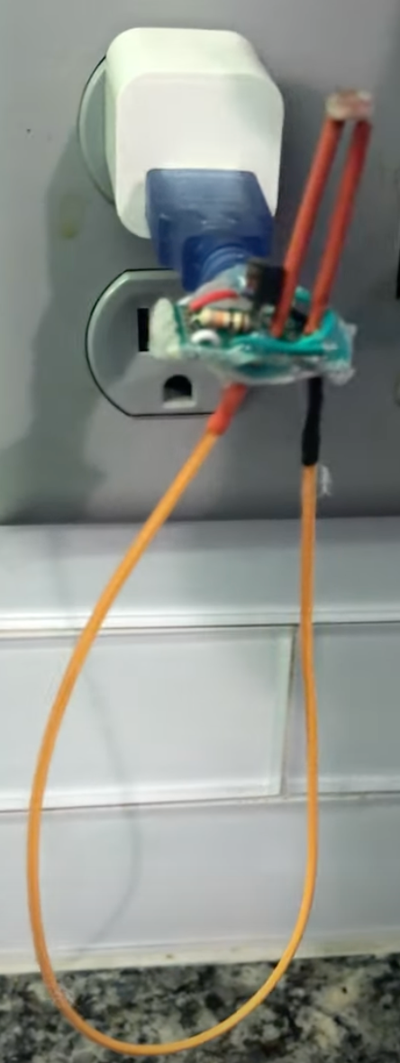
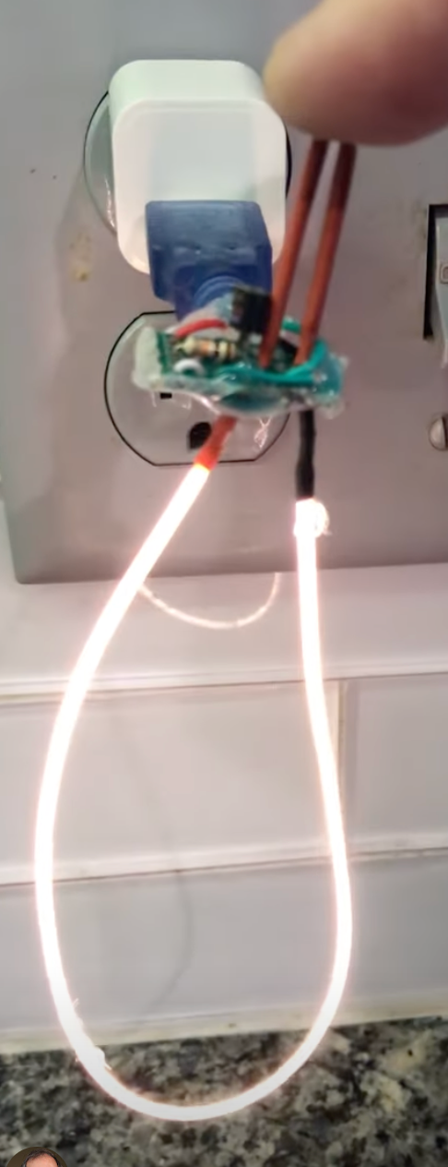
Photo-Sensor
Photo-Sensor
Covered

